Slide 1
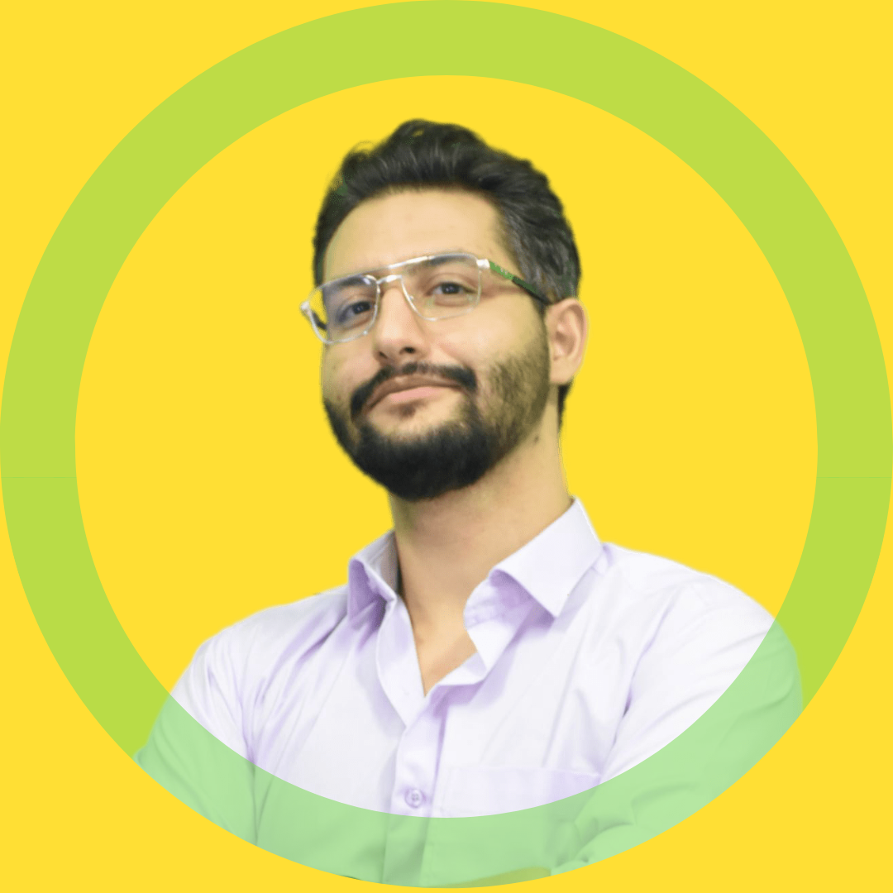






















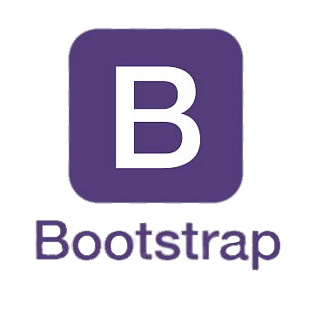



M. SINA
https://www.linkedin.com/in/msinamsina/
https://github.com/msinamsina
ALLAHKARAM
msinamsina@gmail.com
Computer Vision Expert
Full stack Developer
Roboticist
09981075065
https://msina.me
PROFILE
LANGUAGES
As an expert Python programmer who has more than 6 years of experience working on various Computer Vision tasks and web /desktop applications development, Now I'm ready to utilize my experiences in your projects.
Persian
Native
English
Fluent
EDUCATIONAL BACKGROUND
HARD SKILLS
Master's degree | K. N. Toosi University of Technology Mechatronics, Engineering 2019-2023
Thesis Title: Development of an image-based deep neural network for human parsing for human behavior classification
Python
Computer Vision
Deep Learning
Git
Bachelor's degree | K. N. Toosi University of Technology
Electrical and Electronics Engineering 2014-2019
Thesis Title: Hardware implementation of motion estimation function in H.264 video encoder
Linux
Embedded Sys.
Clean Code
SW Architecture
FRAMEWORKS & LIBRARIES
SOFT SKILLS
Teamwork
Problem Solving
Django
Leadership skill

Slide 2


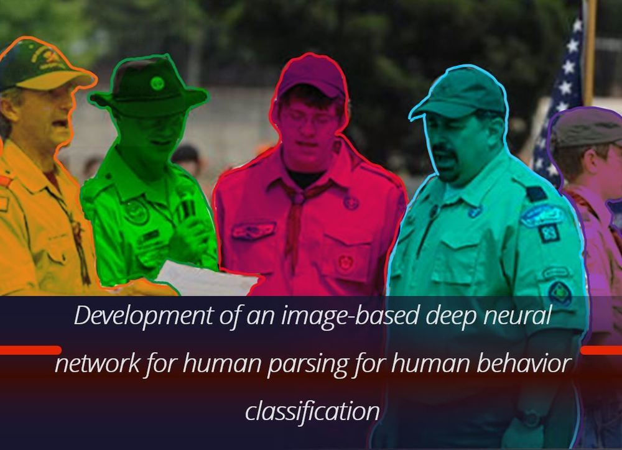





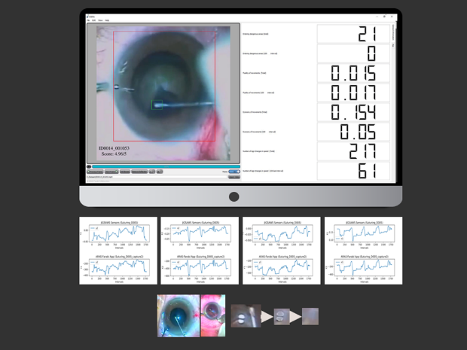
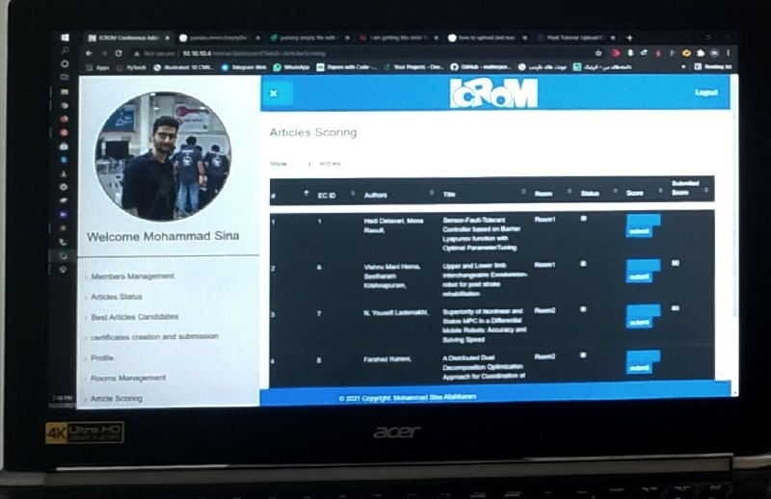
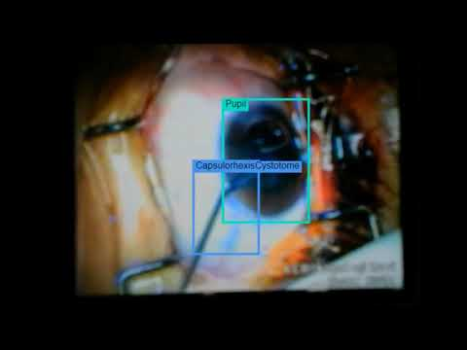
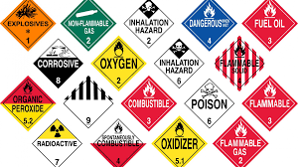
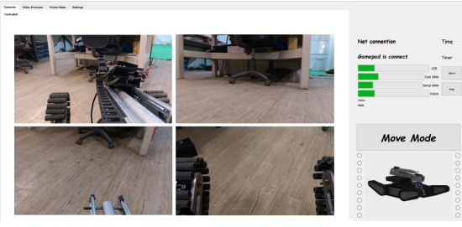
NOTABLE PROJECTS
Parsing-Detectron | A Deep Learning Framework
For Human Parsing Task
https://github.com/msinamsina/Parsing-Detectron
In this project detectron2 framework has been modified. Parsing-Detectron can ether used for detection and segmentation tasks or human parsing task.
PyAutoMail | A Python Package For Large Scale Email Automation
https://github.com/msinamsina/pyautomail
https://pyautomail.readthedocs.io/en/latest/
This python package has can be used for easy email automation an additionally it has an Command-Line interface for creating email queues and send personalized email to your contact lists
ESEL| Eye Surgery Evaluation and Labelling
https://drive.google.com/file/d/1oLa4BN6Livk69FaOX7VSaMq09awFhbCD/view
ESEL is a desktop application which can be used for Capsulorhexis Eye Surgery evaluation based on surgery video. Furthermore this application is used for semi-automated labeling for pupil and surgical instrument detection and tracing task.
Persian Chair | A Web Application For
Evaluating the Articles
Persian Chair (PCH) is a Django web application which is developed based on ICRoM Conference request.
Django
ARAS Deep Learning Framework| A Deep
Learning Framework For object detection
https://github.com/msinamsina/ARAS-DeepLearning-FW
In This project a deep learning frame work is created from scratch for object detection task which is specially used for pupil and Capsulorhexis surgery instrument detection.
Hazmat Detection | Hazardous Materials (HAZMAT)
Sign Detection
In This project a hazardous materials (HAZMAT) sign dataset is prepared and used to train Yolo to create a hazmat detector.
Rescue Robot Remote Control APP | A GUI For
Tele-Operating of UGV Robot
This is a desktop application which is prepared a graphical user interface for control and interact with KN2C Rescue Robot. This application has several sub-application which can handle some tasks automatically like hazmat detection, path-planning and inverse kinematics for 7 DOF Robotic Arm.

Slide 3









EXPERINCES
Freelancer | Self Employed
Software Developer
Computer Vision Expert
Full-Stack Developer
2023-Now
Computer Vision Researcher | ARAS Laboratory
Computer Vision Researcher
Machine Learning Researcher
Software Developer
2018-2023
Full Stack Developer | IT Team of ICRoM Conference
Software Developer
Full-Stack Developer
2018-2023
COO and Software-Hardware designer | Rahbin Sanat Nasir Company
Chief Operating Officer
Human Resources Management
Software-Hardware Designer
Computer Vision Expert
2022-2023
hardware developer | Ride-On company
Digital Electronics Engineer
Embedded Systems Developer
2017-2018
Team Leader, Software-Hardware developer | KN2C Robotic Team
Human Resources Management
Digital Electronics Engineer and Embedded Systems Developer
Software Developer and Desktop Application Designer
Junior computer vision engineer
2014-2018
ACHIVMENTS AND HONOR
Top Rank (Second Place) | In the undergraduate Level (M. Sc) 2023
IEEE Reviewer | Review in IEEE Transactions on Medical Robotics and Bionics 2023
Third place | RoboCup Asia-pacific Rescue robot league 2018
Third place | Iran Open Rescue robot league 2017, 2018
Second place | ICRoM Creative Exhibition 2016
Fifth place | RoboCup Rescue robot league 2017

Slide 4


PUBLICATIONS
https://scholar.google.com/citations?user=ejhATTMAAAAJ&hl=en
ARAS-Farabi Experimental Framework for Skill Assessment in Capsulorhexis Surgery https://ieeexplore.ieee.org/document/9663494/ In this article a new dataset for Capsulorhexis Surgery and a new deep learning frame-work are proposed.
Surgical Instrument Tracking for Capsulorhexis Eye Surgery Based on Siamese Networks https://ieeexplore.ieee.org/document/10025355/ Surgical Instrument Tracking is a challenging task which can be used for surgeon performance evaluation. This paper present a new method for tracking the Surgical Instrument of Capsulorhexis Surgery.
Closed-form Inverse kinematics Equations of a Robotic Finger Mechanism https://ieeexplore.ieee.org/document/9663448 Obtaining Closed-form Inverse kinematics Equations for serial arms with arbitrary structure is a challenging task but in this article a Closed-form Inverse kinematics Equations is proposed which can be use for a large group of serial robots which have less than 5 links.
RoboCup rescue 2017 team description paper KN2C https://robocup-rescue.github.io/team_description_papers/2017/Champ2017_Iran_KN2C.pdf This article is about introducing an UGV, built with the focus on minimizing the reliability on prebuilt parts (both electrical and mechanical) and reducing the total cost as well not only for the robotic competitions but with the goal of later, global uses in rescue missions.
TEACHING EXPERINCES
Computer Vision & Deep Learning Course | ARAS Academy 2022
Robotics for kids | ARAS Academy 2019
Teacher Assistance of Robotics Course |K. N. Toosi university of Technology 2017,2016
Teacher Assistance of Micro-Processors Course | K. N. Toosi university of Technology 2015
Electronic in robotic | KN2C Laboratory 2016
Robotics for kids | Seyidkhandan neighborhood hall 2017

